Slide 1
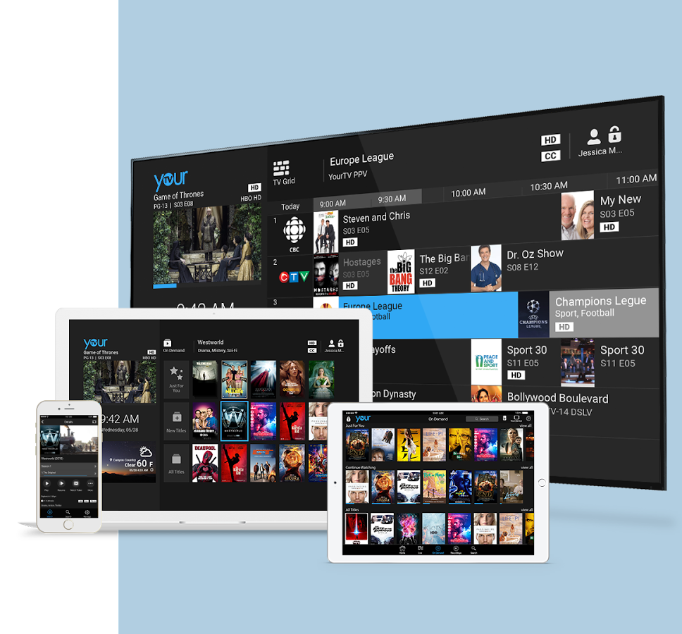
Video Service
Delivery Platform
www.minervanetworks.com

Slide 2
Compelling Subscriber Experience
Filters for ease of discovery
Trending and similars for impulse viewing
Federated search
Personalized recommendations
Consistent experience across devices

Slide 3
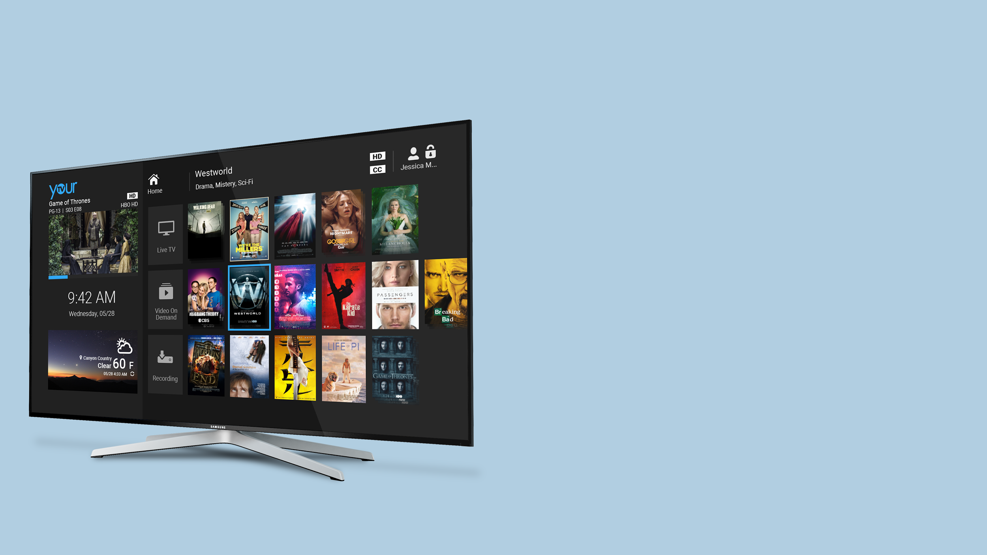
Personalized
Home Page
Personalized recommendations based on viewing history
Live TV, Recordings and VOD all on one page
Continue Watching for rented or partially watched shows

Slide 4
Multi-Screen
Solution
PHONES
TABLETS
STICKS
PLAYERS
COMPUTERS

Slide 5
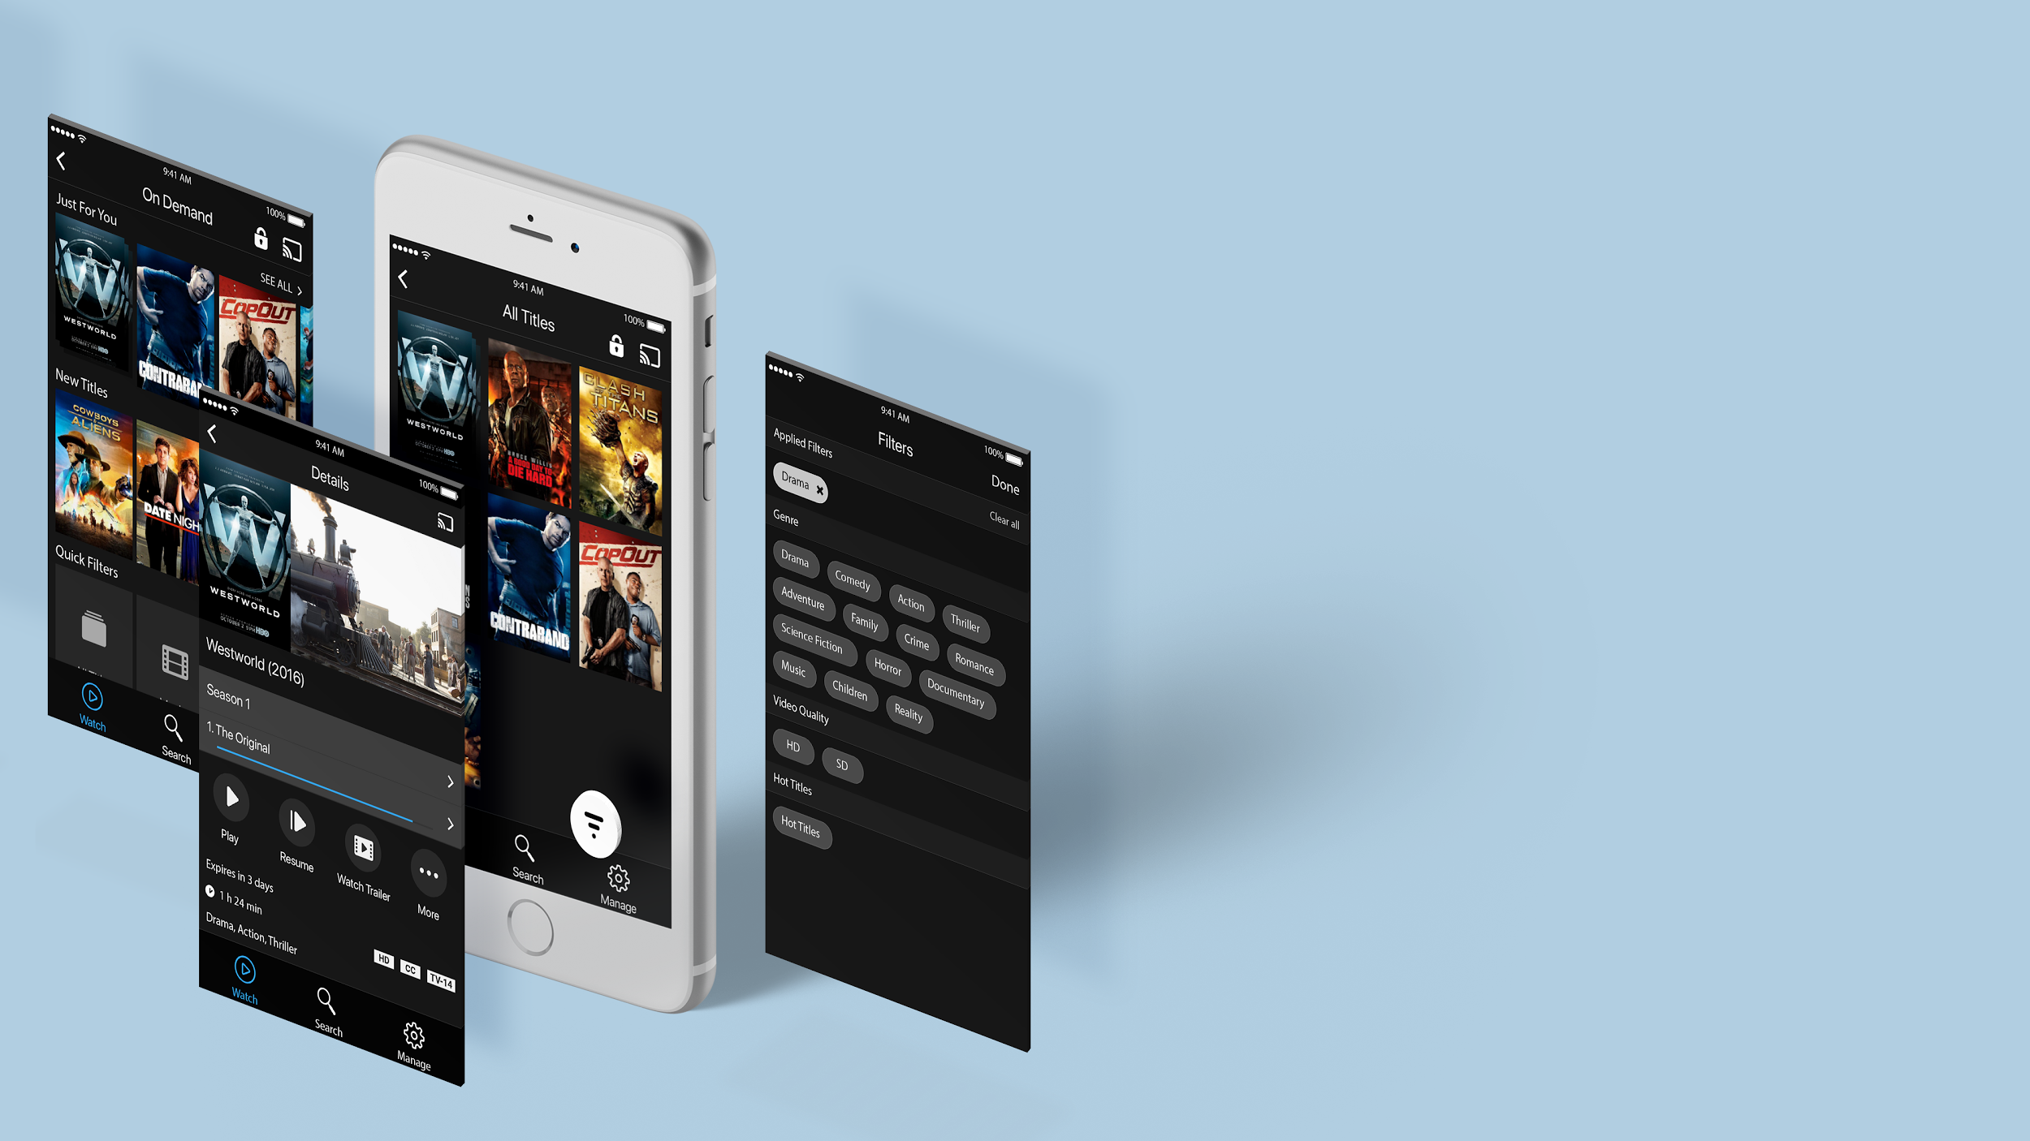
Consistent Experience
On All Platforms

Slide 6
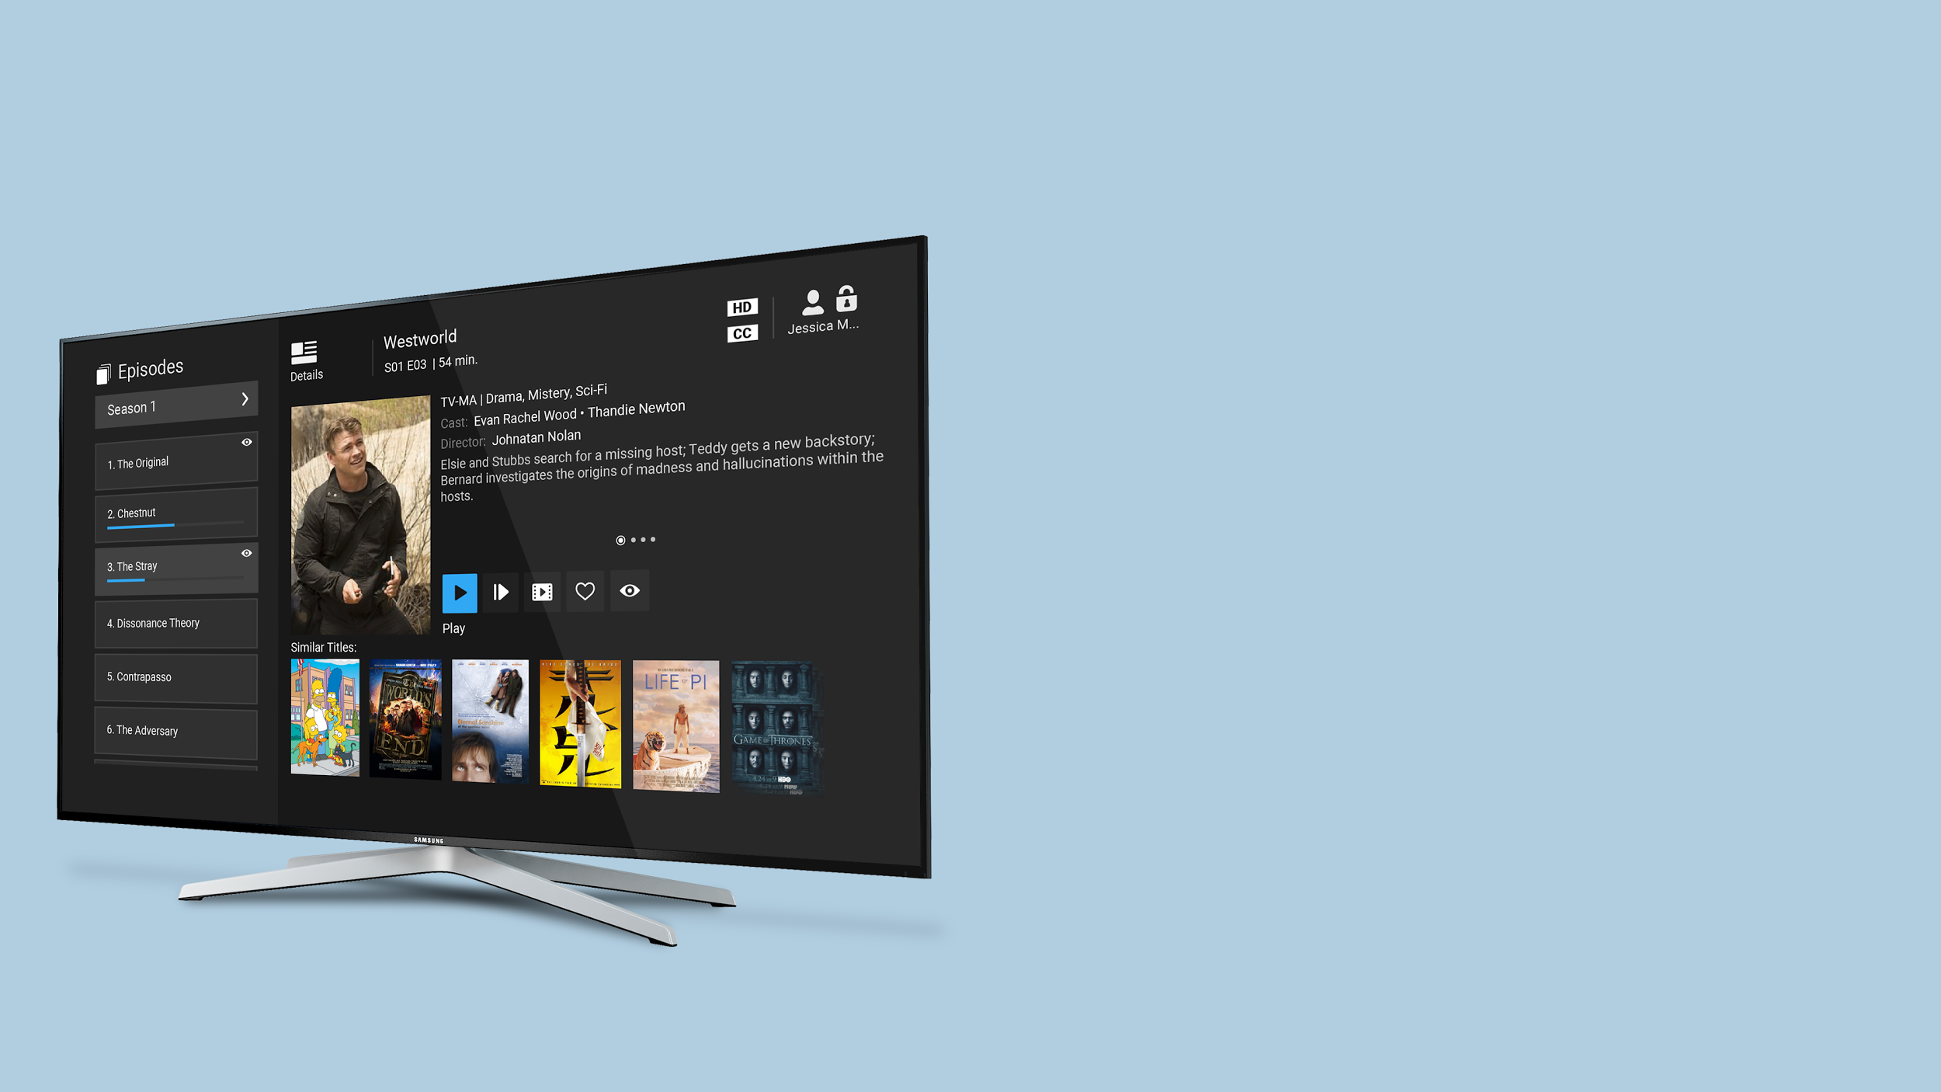
Series and
Binge Watching
SEARCH
BROWSE
FILTER
BINGE VOD SERIES

Slide 7
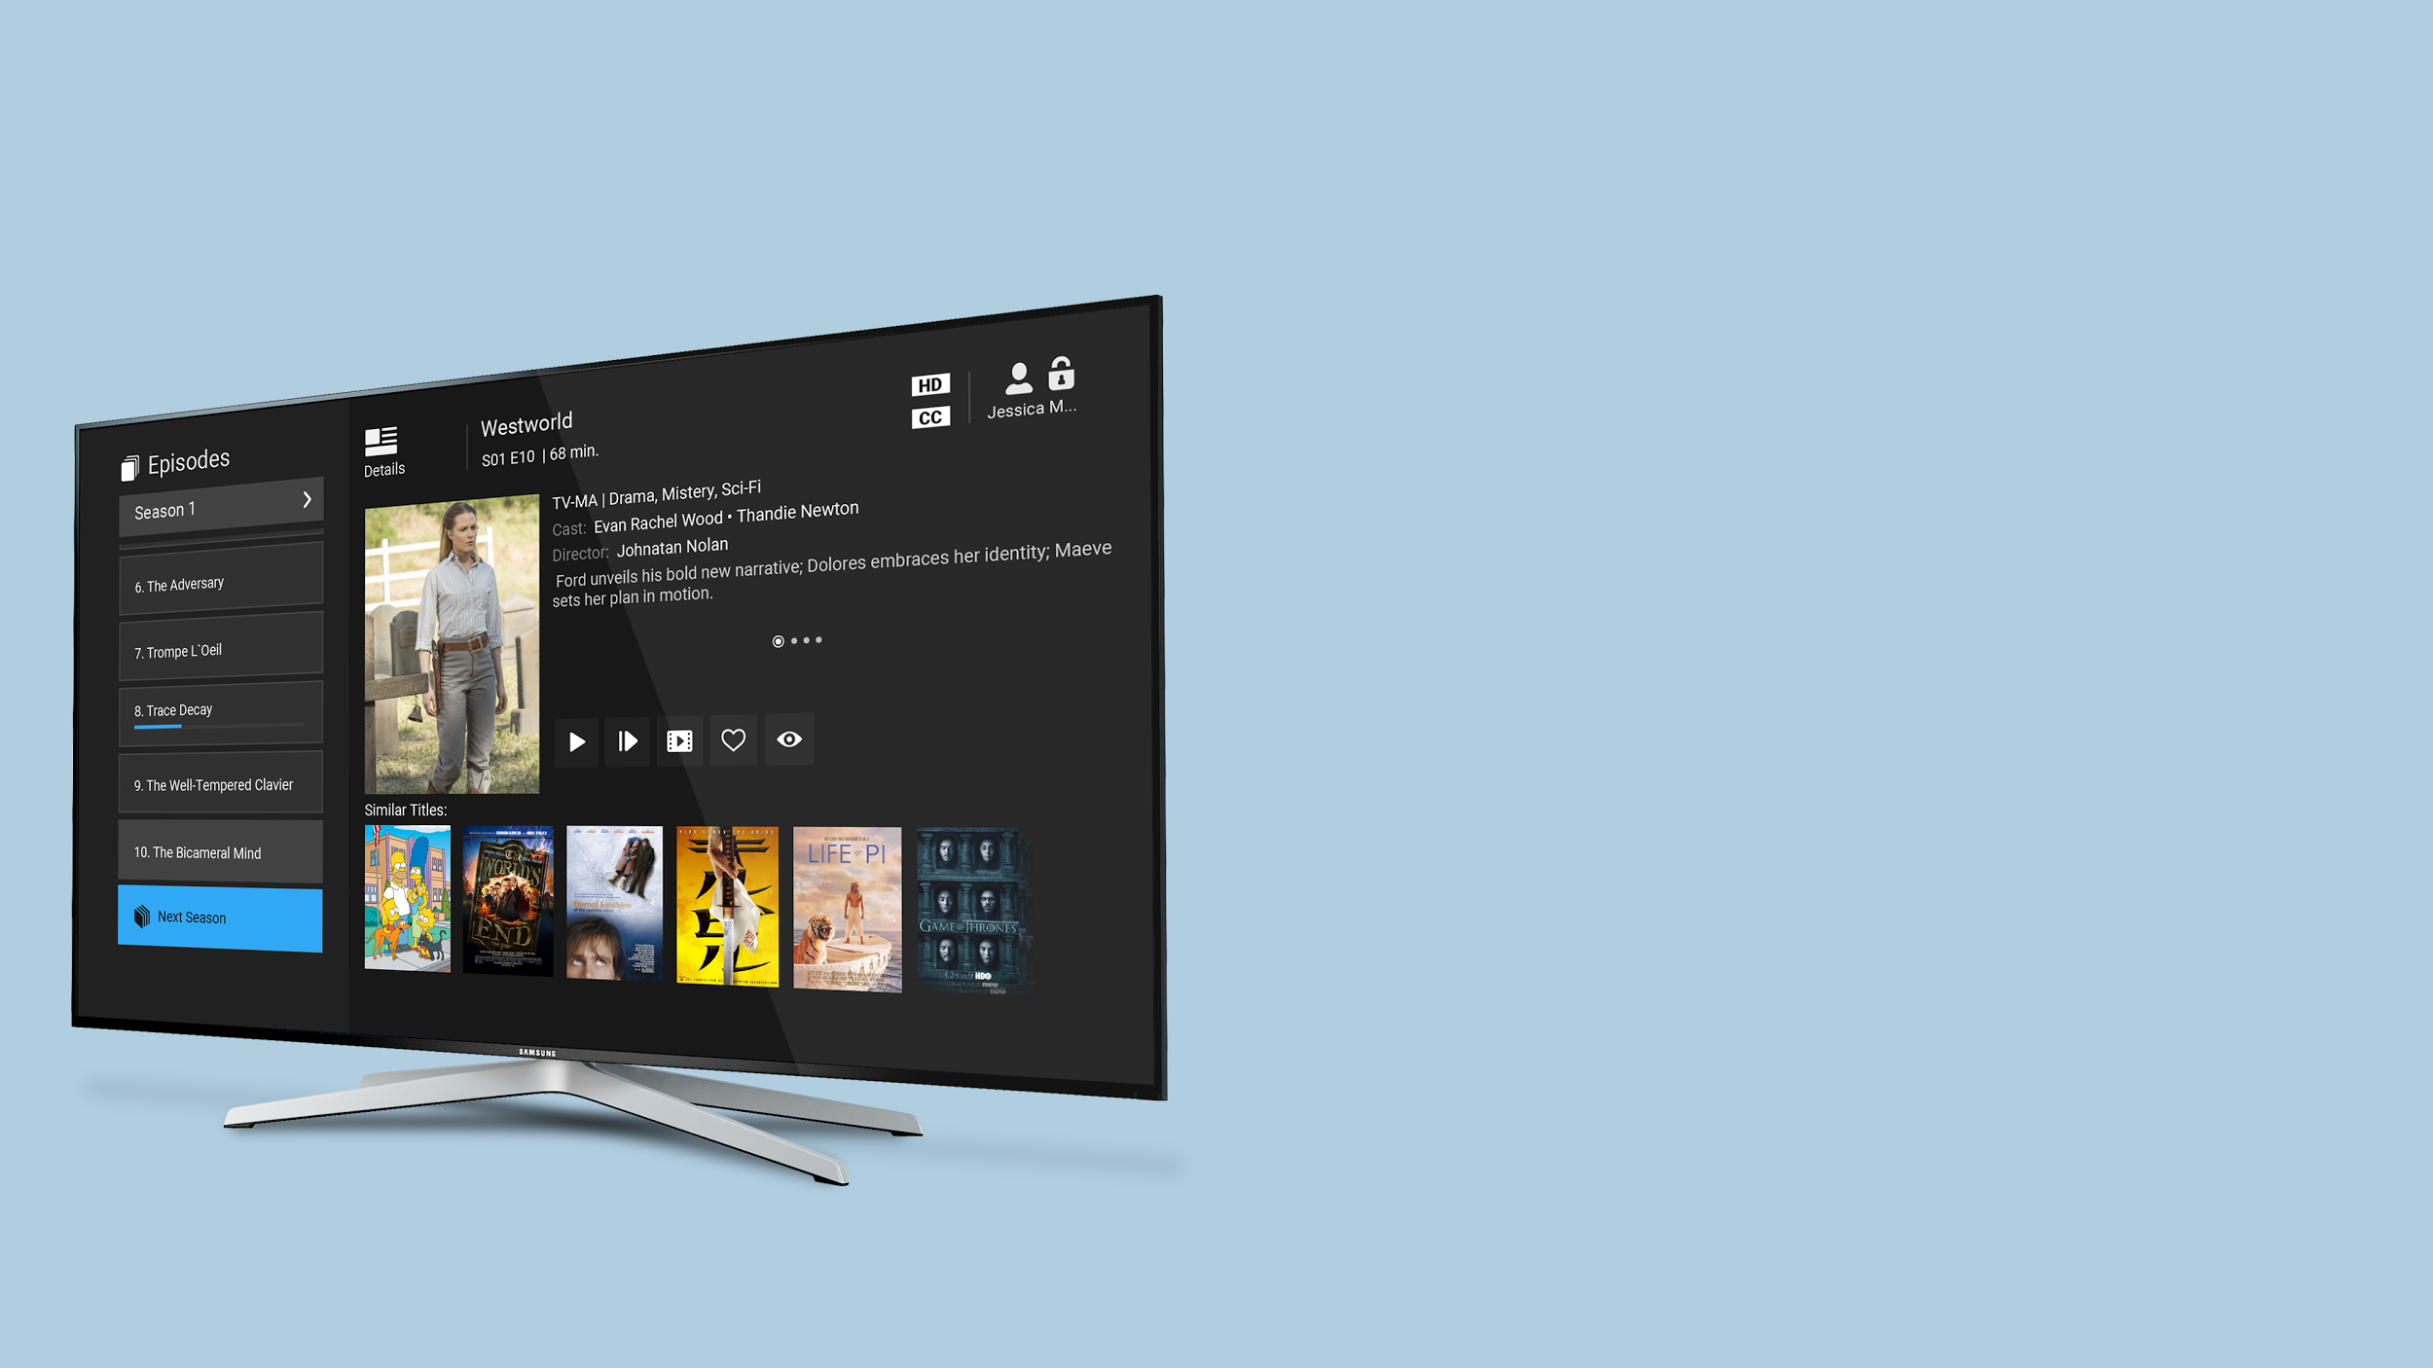
TV Series, Seasons And Episodes
Easily select a season
Scroll through all episodes across seasons
Quickly discover new content from similar titles

Slide 8
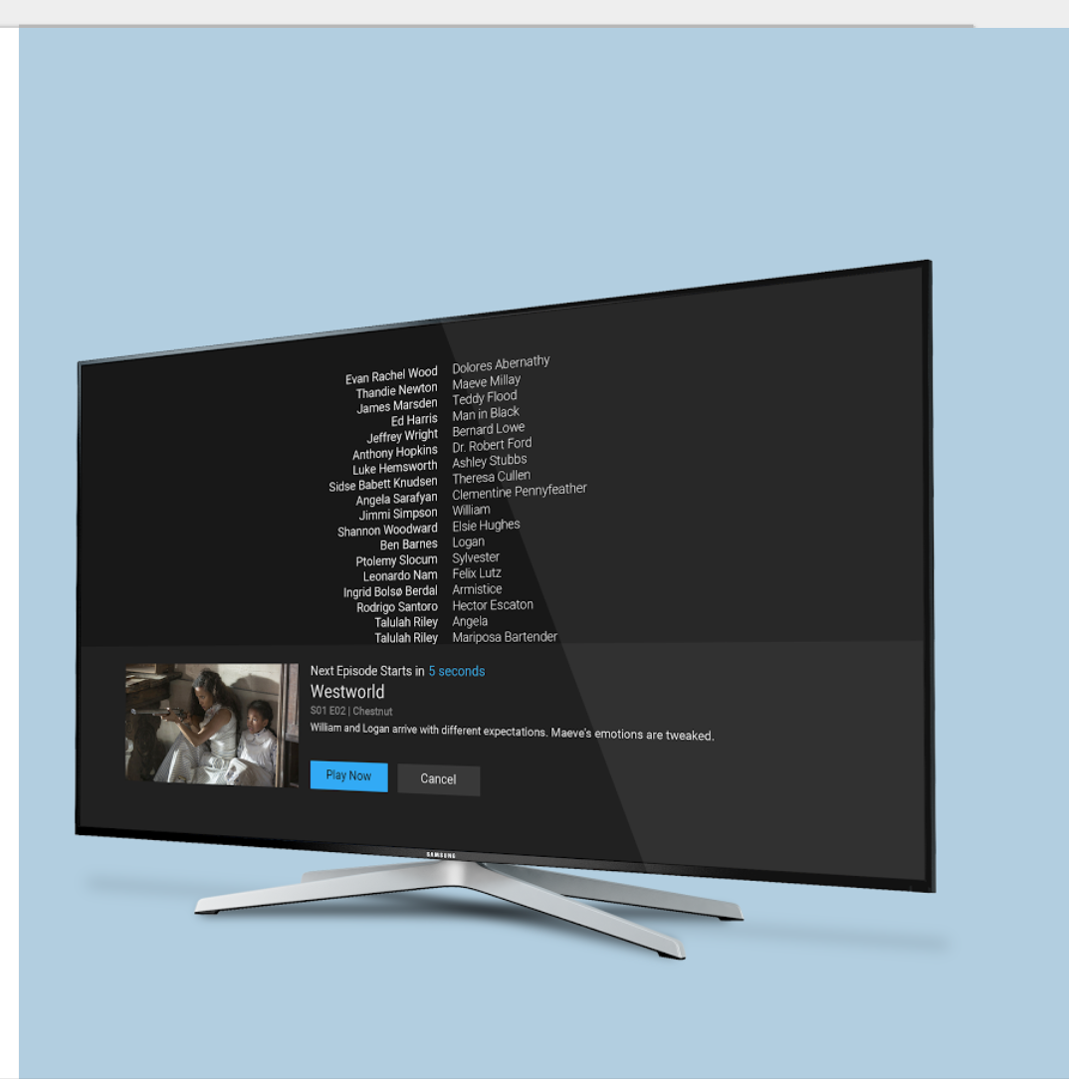
Binge Watching
Autoplay next episode
Recommends similar content if no new episodes are available

Slide 9
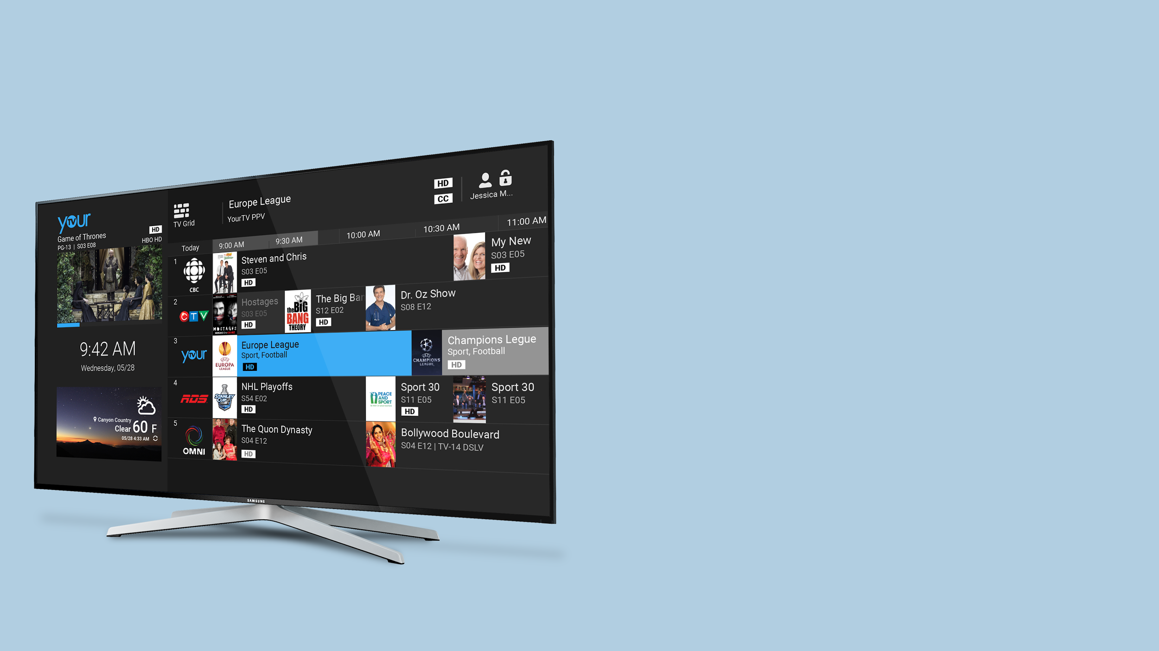
Promotional
Channels
Use EPG for content merchandizing
Enable on-screen purchases of premium channel packages or VOD
Conduct A/B testing

Slide 10
Operator Friendly
Scalable, Cloud Ready, Modular, Open APIs
Migrate From Any Legacy Network
IPTV
CABLE
SATELLITE

Slide 11
Preserve Legacy Investment

Slide 12
EDGE
BACK OFFICE
WAN or Internet
CDN
APP CLIENTS
Access Network
CORE ROUTERS
Cloud Ready, Scalable Edge Architecture

Slide 13
Recommendations
Subscriber Management
Analytics
Video Services Management
Asset & Metadata
Management
Channel & Package Management
Modular, Open
& Scalable Platform
Federated
Search
Device Management

